Slide 1



Slide 2
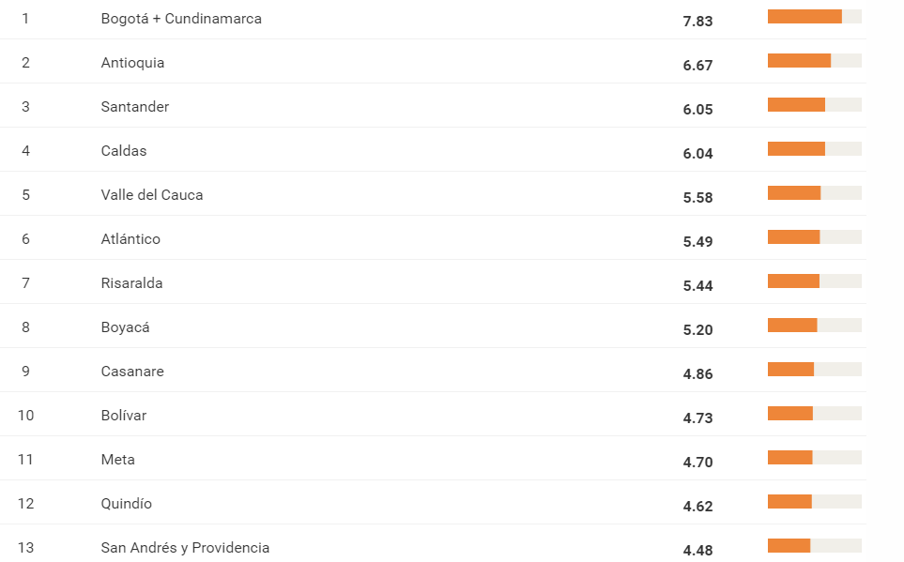
Ranking general – 32 departamentos

Slide 3
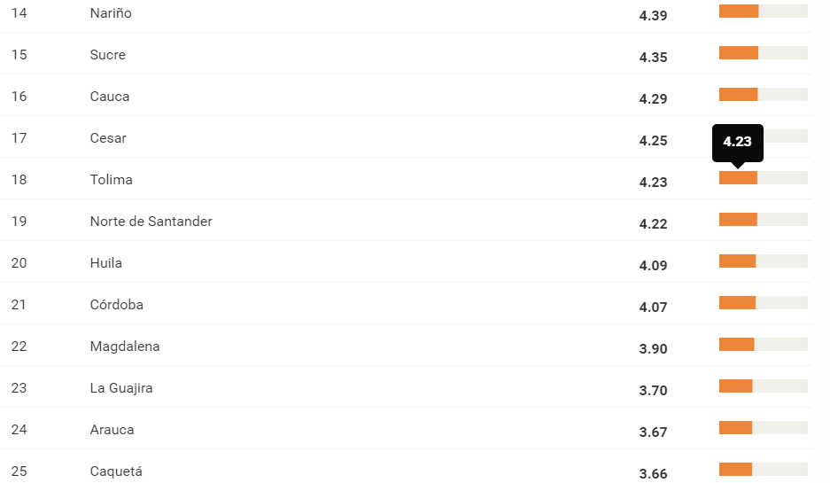

Slide 4
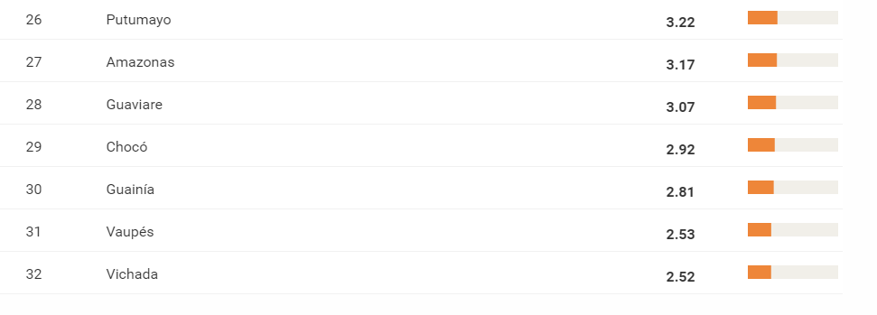

Slide 5


Slide 6


Slide 7


